Slide 1
CHAPTER 15
Sex as a Commodity and the Regulation of Sexuality

Slide 2




Sexual Enhancements and Perceived Inadequacies
z
People seek to improve performance:
  Duration of arousal or ability to maintain arousal regardless of circumstance.
Development of drugs to treat arousal disorders (especially PDE-5 inhibitors) resulted in their common use in erotic films by males:
  Arousal disorder drugs are used recreationally by a small percentage of males in the general population.
Aphrodisiacs: substances that people take to enhance sexual desire, arousal, or performance:
  Have no value beyond placebo effects.
  Poaching of endangered species for animal aphrodisiacs continues to be problematic.

Slide 3

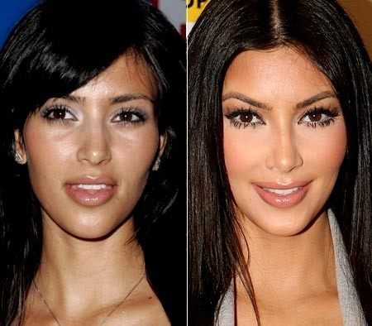

Body Modification
z
Shaving, breast modification, genital surgery, etc.
Universal as well as culture-specific ideals of beauty:
  What is attractive in one culture or era in history may be considered a disfigurement in another culture or era.
Cosmetic surgery procedures: not necessary, but enhance the body to a perceived ideal:
  Modifications to the nose
  Reductions of body fat
  Face lifts and Botox
  Breast surgeries
  Operations to lengthen or thicken the penis
  Other non-surgical techniques
  Modifying the functioning of the vagina

Slide 4
Body Modification
z
Vaginal rejuvenation: techniques to tighten vagina.
Labiaplasty: involves shortening the labia minora – 10,000 annually in the U.S.
Most popular forms of elective cosmetic surgery in the U.S.:
  Lipoplasty (fat removal) – 260,000 annually in the U.S.
  Breast augmentation – 400,000 annually in the U.S.
  Rhinoplasty (nose job) – 220,000 annually in the U.S.
  Abdominoplasty (tummy tuck) – 130,000 annually in the U.S.
All surgeries can have complications.
Most individuals are satisfied despite rates of complications that can exceed 50%.

Slide 5

Bodily Modifications and Adornments

Slide 6

Sexual Objectification
z
Treating another person as a sexual object for own gratification and pleasure, with little consideration of the other as a person.
Cosmetic surgery:
  Intimately tied with cultural conceptualizations of beauty and gender.
  Disproportionately sought by women who learn dissatisfaction with their natural bodies.
Secular feminist perspective:
  Immoral
  Related to the historical tendency of patriarchal societies to diminish the status and power of women:
    Women valued more for beauty than mind or ability.
  Anything that removes a relationship and emphasizes sexual pleasure of just one person is considered objectification.

Slide 7
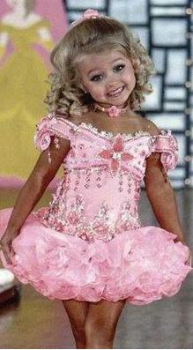
Sexual Objectification
z
Contemporary feminist perspective:
  Moral value of agency:
    If a person freely chooses to be objectified, and enjoys it, it may be acceptable for both the person being objectified and the consumer.
Media consumption measurably affects body image:
  Distorted body image can relate to psychological disorders.
Sexualization of children and adolescents:
  Critiqued for stealing childhood innocence:
    Example: child beauty pageants are dominated by traditional notions of beauty and femininity.
  Cultures have varied widely in terms of:
    Expectations and roles assigned to children.
    Age at which adult roles and expectations begin.

Slide 8
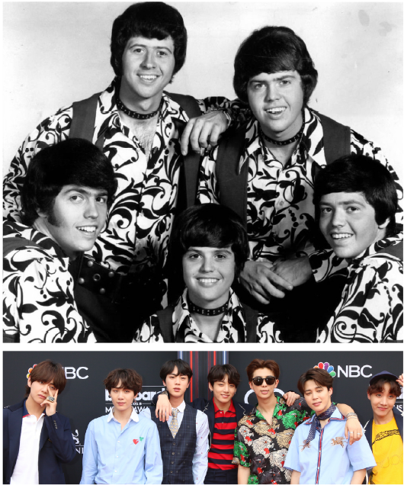

Varying Body Standards for Popular Males

Slide 9
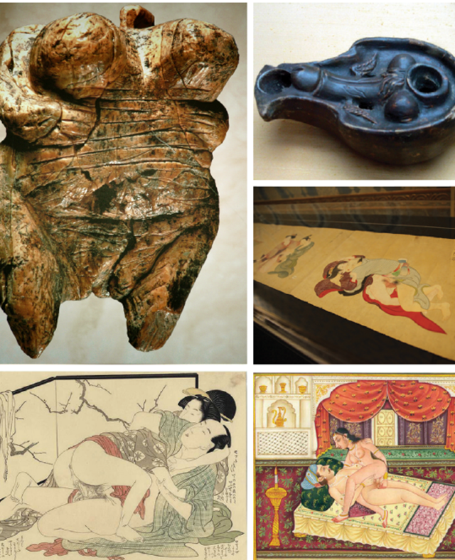
Erotica
z
Representations of people and sexual acts in literature, art, photography, and video for the purposes of sexual pleasure of the recipient:
  Known as pornography.
Earliest pre-historic art included erotic sculptures dating to over 35,000 BCE.
Obscene: suggests that the material is inappropriate and access to it should have restrictions:
  Applied to material of a sexual nature.
According to different cultures and contexts sexually explicit materials may:
  Have artistic, ceremonial, ritualistic, or religious use or meaning.
  Primarily be for sexual stimulation and pleasure.
  Have multiple meanings and uses.

Slide 10
The Law: Art, Porn, and Free Speech
z
What is innocuous in one country and time may be illegal in the very same country and time depending on the context.
Abrahamic religions held negative views of sexuality and sexual pleasure outside of a female-male marriage:
  Protestant Reformation encouraged a more restrained, less opulent expression.
  Catholic Church banned nude portrayals in art.
Over the centuries laws on erotica were modified as definitions of artistic merit, erotica, pornography and obscenity changed.
Modern laws in many countries:
  Regulate sexually explicit materials and nudity.
  Place restrictions on the age at which people may purchase sexually explicit material.
  Societies that choose to regulate such materials wrestle with defining what is artistic, erotic, or obscene.

Slide 11
The Law: Art, Porn, and Free Speech
z
Relevant U.S. Supreme Court cases:
  Griswold v. Connecticut (1965) – ruled that the Constitution protects the liberty of married couples to buy and use contraceptives without government restriction.
  Eisenstadt v. Baird (1972) - established the right of unmarried people to possess contraception on the same basis as married couples.
  Roth v. United States (1957) - redefined the Constitutional test for determining what constitutes obscene material unprotected by the First Amendment.
  Case of Marvin Miller (1973) – whether or not something is obscene is to be evaluated according to a "community standard,“ and if a "reasonable person" would evaluate the work as one that lacks "serious literary, artistic, political, or scientific value".
  U.S. v. Stevens (2010) - a federal statute criminalizing the commercial production, sale, or possession of depictions of cruelty to animals, was an unconstitutional abridgment of the First Amendment right to freedom of speech.

Slide 12
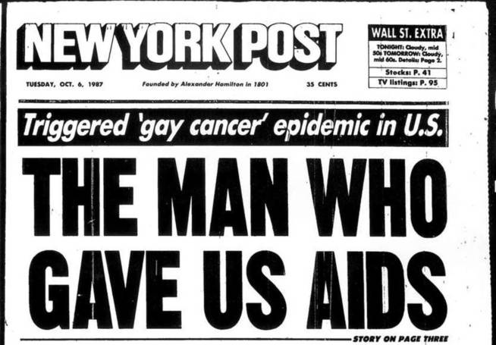
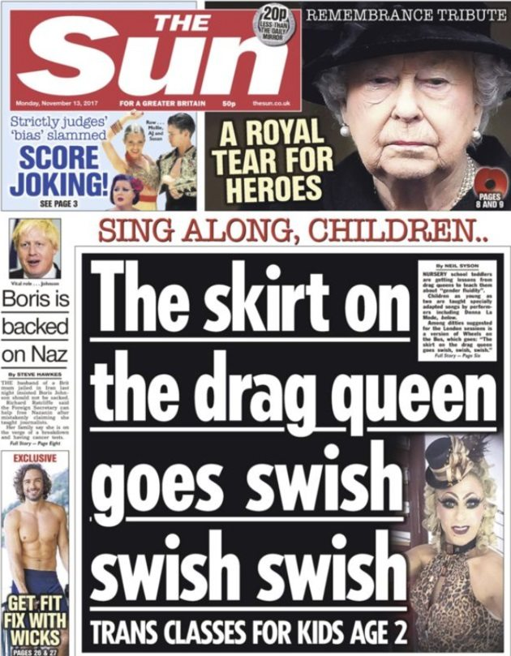
Sex Panics
z
Moral panics about sexuality and sexual rights:
  Popular reaction among social conservatives to perceived changes in society:
    Example: sexual revolution of 1960s with the advent of oral contraception.
  Linked to a carefully orchestrated campaign to solidify voters in political races:
    Example: campaigns against same-sex marriage.
  Fueled primarily by media organizations seizing on a provocative headline.

Slide 13

Scholarly Research on Pornography
z
Focused on visual pornography:
  High-quality images in erotic magazines and video materials distributed via internet.
Controlled studies experiments:
  Volunteers may or may not be exposed pornographic images.
  Effects on behavior, mood, or attitudes are measured.
Correlational studies look at correlations between self-reports of pornography use and measures such as:
  Attitudes
  Relationship satisfaction
  Presence or absence of reported disorders

Slide 14
Scholarly Research on Pornography
z
Large-scale contrasts:
  Compare similar countries that have different laws on the availability of pornography.
  Study the impact of sudden change in law on rates of crimes within a country.
Intends to find whether pornography leads to:
  Objectification of women.
  Any negative impact or plays an association in actual violence towards women.
Relationship between pornography, paraphilias, and relationship intimacy may be due to:
  Imbalance in partners with paraphilic interests in heterosexual populations leading to sexual compatibility issues.
  Narrowness of arousal patterns in some individuals with kinks and fetishes leading to difficulties in non-paraphilic sexual activity.
  Partner attitudes towards kinks and fetishes and accommodating them.

Slide 15
Research Focus
z
Allen, D’Alessio & Brezgel, 1995:
  A large meta-analysis of experimental studies indicated:
    Exposure to nudity reduced subsequent aggression.
    Exposure to nonviolent sexual activity increased subsequent aggression to some degree.
    Exposure to violent sexual activity increased aggression the most.
  Pornography is a poor, and indeed dangerous, sex educator.

Slide 16
Pornography, Violence and Sexual Offending
z
Research studies have indicated:
  Those who committed violent crimes against women did not have more pornography exposure than others.
  Clear links exist between pornography use and sexually aggressive behavior in a subset of males who at high risk on other factors also are associated with sexual aggression.
    Men who have other anti-social characteristics

Slide 17

Other Types of Erotica
Slash fiction: fan-written fiction primarily read by heterosexual women:
  Portrays male-male sexual relationships among fictional characters who are heterosexual in the original form.
z

Slide 18

Sexting
z
In the U.S., statutes against distributing sexual images of children or adolescents include:
  Consensual transmission of images by those under the age of 18 to one another (sexting):
    Some states identify adolescents as sex offenders under laws established to punish adults having sexual contact with children.
Electronic media make it possible for previously private behavior to become public:
  Creates career difficulties for some individuals, particularly politicians.

Slide 19

Sex and Brain Differences in Pornography Use
z
Analyses suggest that females may prefer different types of pornography:
  Market for erotic literature is much larger among females than males.
  Market for visual pornography is larger among males than females.
  Females appear to respond physiologically to visual erotica in similar ways as males.

Slide 20
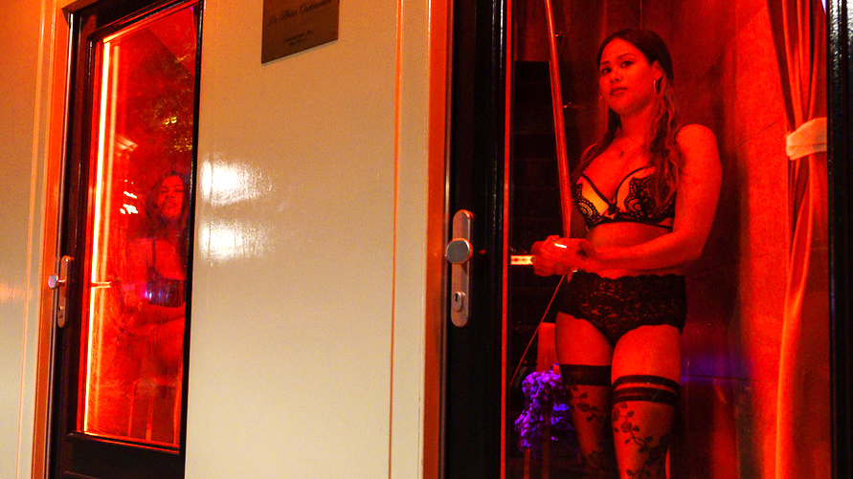
Sex Work From a Distance
z
Sex work: receiving money for having direct sexual contact with another person.
  E.g. prostitution
Sharing sexually explicit photographs or videos of self without any charge via the Internet on amateur porn sites.
Selling videos of self masturbating or having sex or being hired to do so.

Slide 21

Legal Regulation of Other Types of Sexual Behavior
z
Reasons for enjoying having sex in non-private places:
  Excitement of being discovered
  Violations of taboo
  Enjoyment of nature or open spaces
Anecdotal reports suggest raids and undercover police sting operations are performed when:
  A park or restroom develops a reputation for cruising.
Evolutionary reasons for incest avoidance, in addition to strong cultural taboos:
  Secular reasons against sibling intimate relationships.
  Potential of genetic defects in case of conception.
  Counter-argument is that if behavior is consenting among adults, it should be permitted.

Slide 22
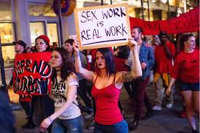
A Spectrum of Selling in-Person Sex
z
Prostitution or sex work: receipt of money from someone for having sexual relations with that person:
  Prostitute and sex worker
  Neither term has a particularly positive connotation in contemporary societies.
Written records of prostitution in ancient agricultural societies exist.
Gender imbalance:
  Significant factor in sex work of all types.
  Vast majority of clients are males, vast majority of sex workers are females:
    Historically attributed to evolutionary sex differences.
    Sex tourism.

Slide 23

Strip Clubs
Mostly have female workers catering to male clients.
Research suggests that sex imbalances exist in recreational use of strip clubs:
  Strip clubs do exist that cater to female clients.
May charge workers a fee for performing:
  Workers then make their wages from tips and performing lap dances.

Slide 24
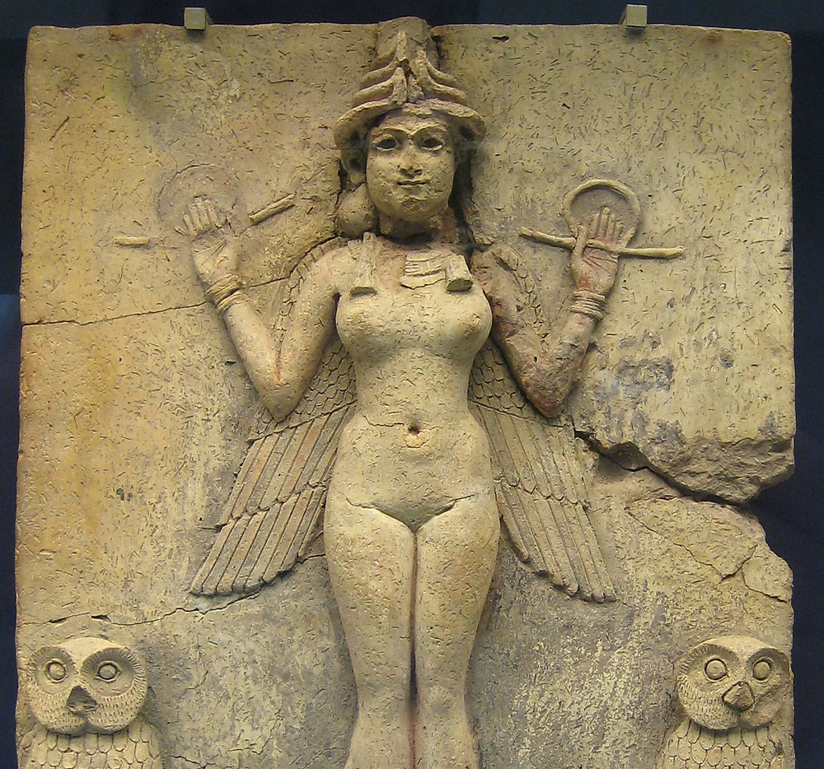

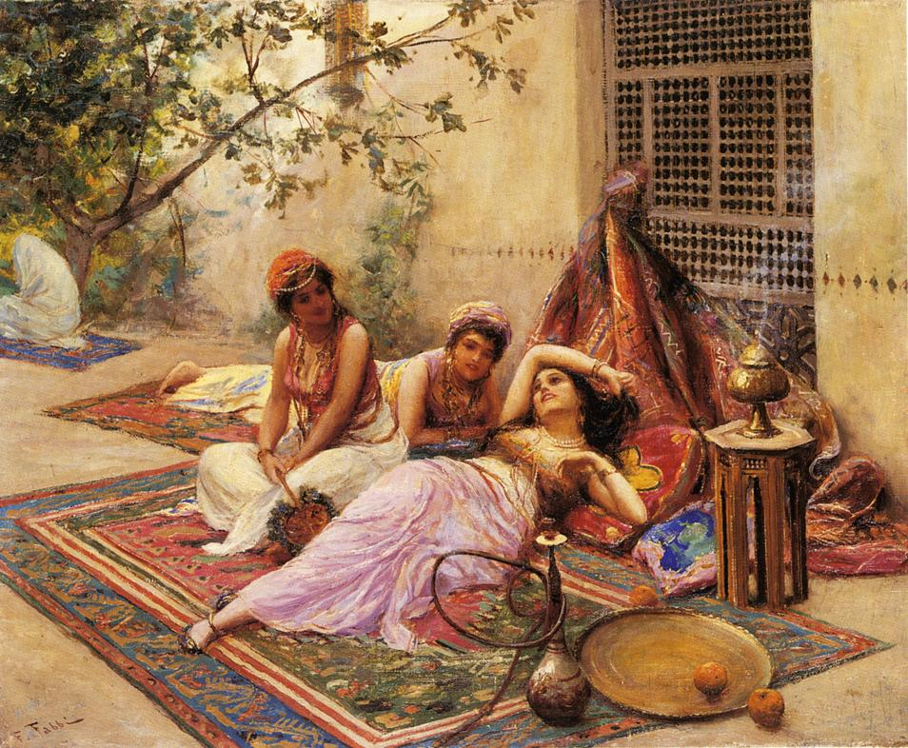
Sacred Sex Workers and Courtesans
z
Prostitutes have been documented as being affiliated with temples and places of worship:
  Greece, India, and Babylonia
Patriarchal pre-industrial cultures with elaborate monarchies or royalties had following types of roles:
  Geishas in feudal Japan
  European monarchs and lesser nobility had courtesans
  Monarchs in Islamic societies had harems
High-end sex workers continued to be associated with modern industrialized societies:
  High-end escort services: males may pay $10,000 or more for an evening of companionship with a highly educated female sex worker:
    Typically young, unattached, and may have only a small number of clients.

Slide 25
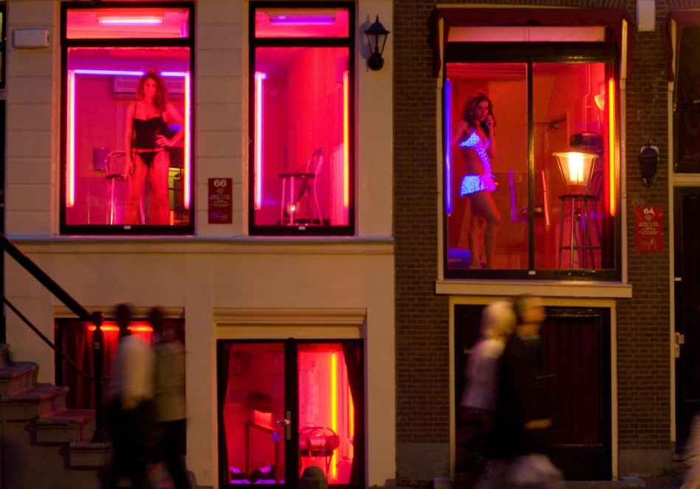
Brothels and Mid-Price Sex Work
z
In some places, brothels are legal and taxed.
In others, they are illegal but tolerated.
In still others, they are strictly prohibited.
Countries with legal and regulated brothels include Germany and parts of the Netherlands:
  Workers are taxed.
  Inspections, including health inspections, are performed at regular intervals.
In the U.S., brothels are legal only in certain counties of Nevada.

Slide 26
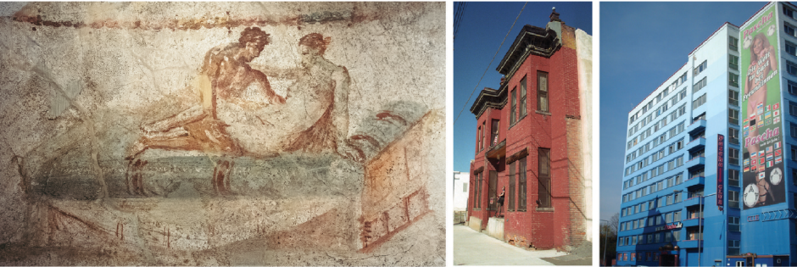
Brothels from Antiquity, to Montana, to Germany

Slide 27
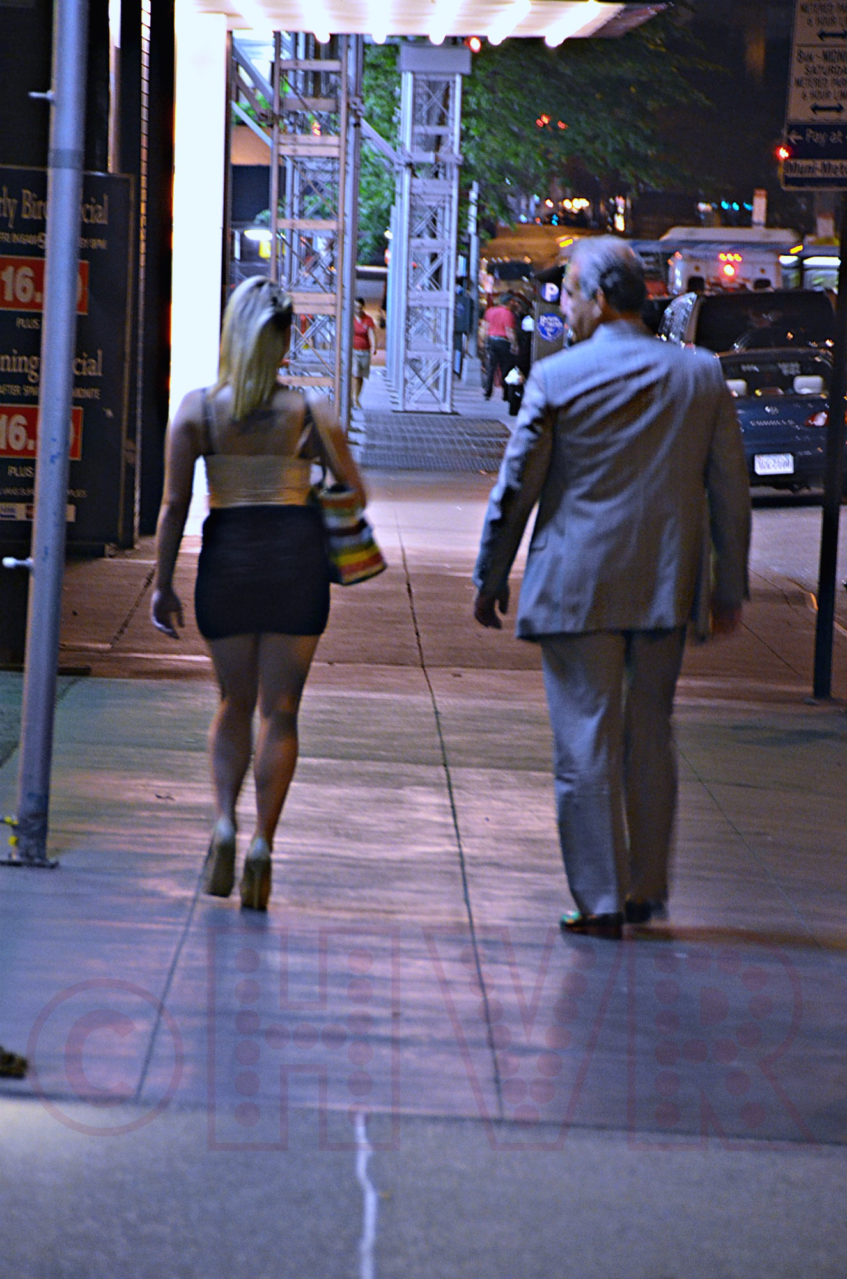

Street Walkers and Hustlers
z
Most dangerous type of sex work and also the lowest paid:
  Workers may work for a pimp who takes some of their earnings, or may freelance.
  Services generally performed in a client’s vehicle.
  Street walking is legal in Germany.

Slide 28
Ethics, Morality, and Laws Regarding Sex Work
z
Medieval Christian Europe:
  Prostitution was viewed as being necessary and leading to lower levels of sexual passions than if it were outlawed.
Contemporary Abrahamic religious perspective:
  Prostitution is inherently immoral.
Secular perspective:
  In favor of prostitution:
    Legalize and regulate.
  Against prostitution:
    Inequality and sexism are inherently involved in because of the gender imbalance.
    There is an element of economic exploitation.
Perspective from sex workers and some feminists:
  Some people enjoy sex work and this should be a choice a person about his or her own body.

Slide 29
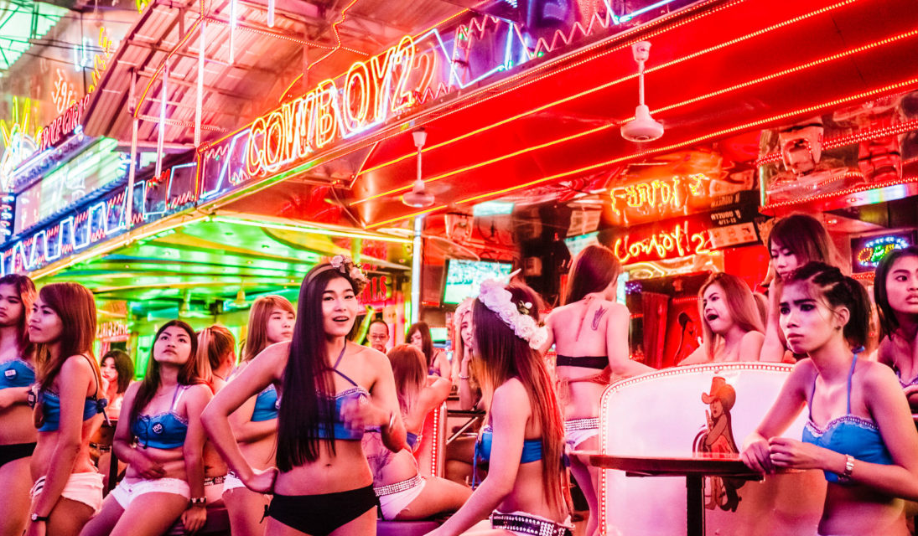
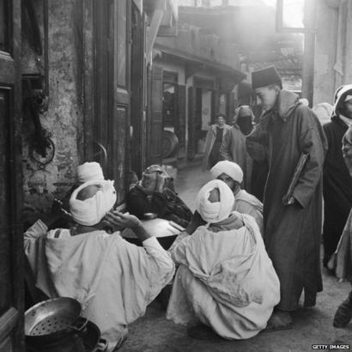
Sexual Tourism and Gigolos
z
Sexual tourism: travel that is specifically for seeking sexual services:
  People traveling to similarly developed economies.
  Bangkok has long been a center in Southeast Asia for male-to-female gender reassignment surgery.
  In the colonial era, the city of Marrakech in Morocco had a reputation for catering to gay male sex tourists from Europe.
Majority of sex workers in developing economies are female, catering to males:
  Considered a driving force behind coercion and trafficking of sex workers.
Gigolo: male who receives money for providing sexual services for a female.

Slide 30
Human Trafficking, Sexual Slavery, and Exploitation
z
Human trafficking: illegal movement of people across national borders:
  Voluntary: when people emigrate (legally or otherwise).
  Involuntary: refugees fleeing conflicts or being forcibly displaced.
Largest proportion of sexual slavery is within and between developing economies:
  Children, particularly girls, are trafficked from rural to urban areas.
In developed economies:
  Documented cases of forced prostitution exist, but represent a small percentage of sex workers.
  Most sex workers are not in sexual slavery nor were trafficked.
  Not all sexually exploited youth are forced to sell sex.

Slide 31
Forced Labor and Human Trafficking

Slide 32
Regulation of Sexuality in the Modern World
z
Enormous economic disparities between nations.
Changes of the scientific era and industrial revolution have dramatically changed gender roles, sexuality, family life, health and welfare:
  Only for a fraction of the world’s population.
  Industrialization and economic development has had somewhat similar influences in quite different parts of the world.
Predictions:
  As economic development spreads, there will be a slow equalization of values and behaviors with regards to sexuality.
  Regional disparities are likely to continue in cultural and legal regulation of many aspects of human sexuality due to:
    Inequality of economic development.
    Diversity of religious traditions.

Slide 33

Gender and Sexual Equity
z
Social and cultural inequities between females and males are likely to persist for much of the 21st century:
  Efforts to legislate equality have met with success in Nordic countries.
  Some biases may remain and objections may be common.

Slide 34

Research Focus
z
Moss-Rascusin, Dovidio, Brescoll, Graham, & Handelsman, 2012:
  Cognitive processes involved in implicit biases point to the role of unconscious bias.
  It is difficult for people to overcome implicit biases even when consciously they do not appear biased.
  Changing the name of a target job candidate for a lab manager position from Jennifer to John resulted in:
    Male faculty offering John a 12.5% higher salary
    Female faculty offering John a 17.3% higher salary

Slide 35
Integrative Themes from Sexuality Research
Most aspects of sexuality involve a rich interplay between evolved mechanisms and cultural inputs.
Danger for individual researchers, journalists and popular reports to focus exclusively on the biological or social and cultural aspects.

Slide 36
Future Trends in Sexuality, Technologies and Society
z
Speculative fiction:
  Fantasy
  Science fantasy
  True science fiction:
    Some far-out ideas about technology, gender and sexuality that may or may not develop, but are at least possible.
Technology can dramatically transform our expectations about gender and gender roles.

Slide 37

Future Trends in Sexuality, Technologies and Society
z
Speculations for the future:
  LGBTQ+ equality will continue to be unequally distributed worldwide for many decades.
  Robot prostitutes.
  Antiviral treatments for HIV and other viruses will be developed.
  Casual sex will become more common.
  New STIs will emerge.
  Virtual sex with realistic encounters that look like actual people.
  Genetic and reproductive technologies will have advanced to physical trait selection.

